Slide 1


Choosing the right location for opening a new coffee shop in Pune, India
Capstone Coursera Project

Slide 2
Background
Worldwide experts estimate that people drink about 2.5 billion cups of coffee a day. Sales in the ready-to-drink market which includes coffee shops are forecast to grow by 67% between now and 2022. Thus its a good business idea to open a coffee shop.
But obviously its not necessary that a new coffee shop owner will be immediately successful, only because that business has a good growth rate in market .There are several things that he/she needs to consider in order to succeed. Data science can help this person in several ways. One of those is to help him or her to find the best location for opening the coffee shop.

Slide 3
Business Problem
In Pune (India), love for 'tea' is more than 'coffee'. Bur still, number of coffee lovers is no less. Mainly, college students prefer coffee shops over tea shops for hanging out. Thus, to open a new cafe its better to find a location, which is near to a college/ colleges.
Now how can Data Science help the person to choose the right location?
We can use FOURSQUARE location data to help the person.
Who would be interested in this project?
Anyone who wants to open a new successful coffee shop in Pune.

Slide 4
Data Description
For this project I used Foursquare developer.
Data :
Foursquare location data of Colleges and Universities in 5 areas in Pune.
Foursquare location data of Coffee shops in 5 areas in Pune.

Slide 5
How can we find the best location?
If we compare the areas in Pune on the basis of no. of colleges located in each area, we will get an area which has maximum no. of colleges. Thus, probability of getting higher response to the new coffee shop increases as we have found the right place targeting the right customers.
But, what if that area already has enough no. of coffee shops ?Then the chances of students trying a new shop become very less. For the businessman its always better to avoid competition at first, when his product/service is new in the market.

Slide 6
How can we find the best location?
Now if we compare the areas based on the no. of coffee shops that already exist in that area, we can get an area with minimum no. of coffee shops.
Thus, in the end, we would get an area with maximum no. of colleges (ie. More target customers) and least no. of coffee shops ( ie. Less competition).
This will be an idea location for opening a new coffee shop and in this way businessman’s problem would be solved.

Slide 7
Methodology
First I chose 5 main localities from Pune, to work with. Those are as follows :
Sadashiv peth
Katraj
Kothrud
Hadapsar
Narhe
I used a Jupyter python notebook for the analysis.

Slide 8
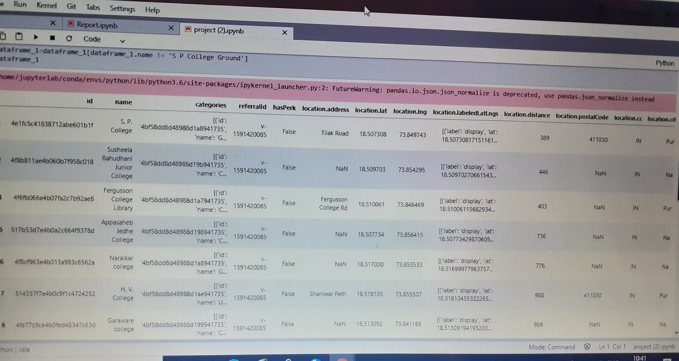
Methodology
Then I used Foursquare api to get a list of colleges with details such as name, latitude, longitude and category; situated in each 5 localities.
The picture shows the list of colleges for first location ie. ‘Sadashiv Peth’
Then I got such a list for remaining 4 areas.
Using dataframe.shape function in pandas I calculated the number of colleges for all the localities.

Slide 9
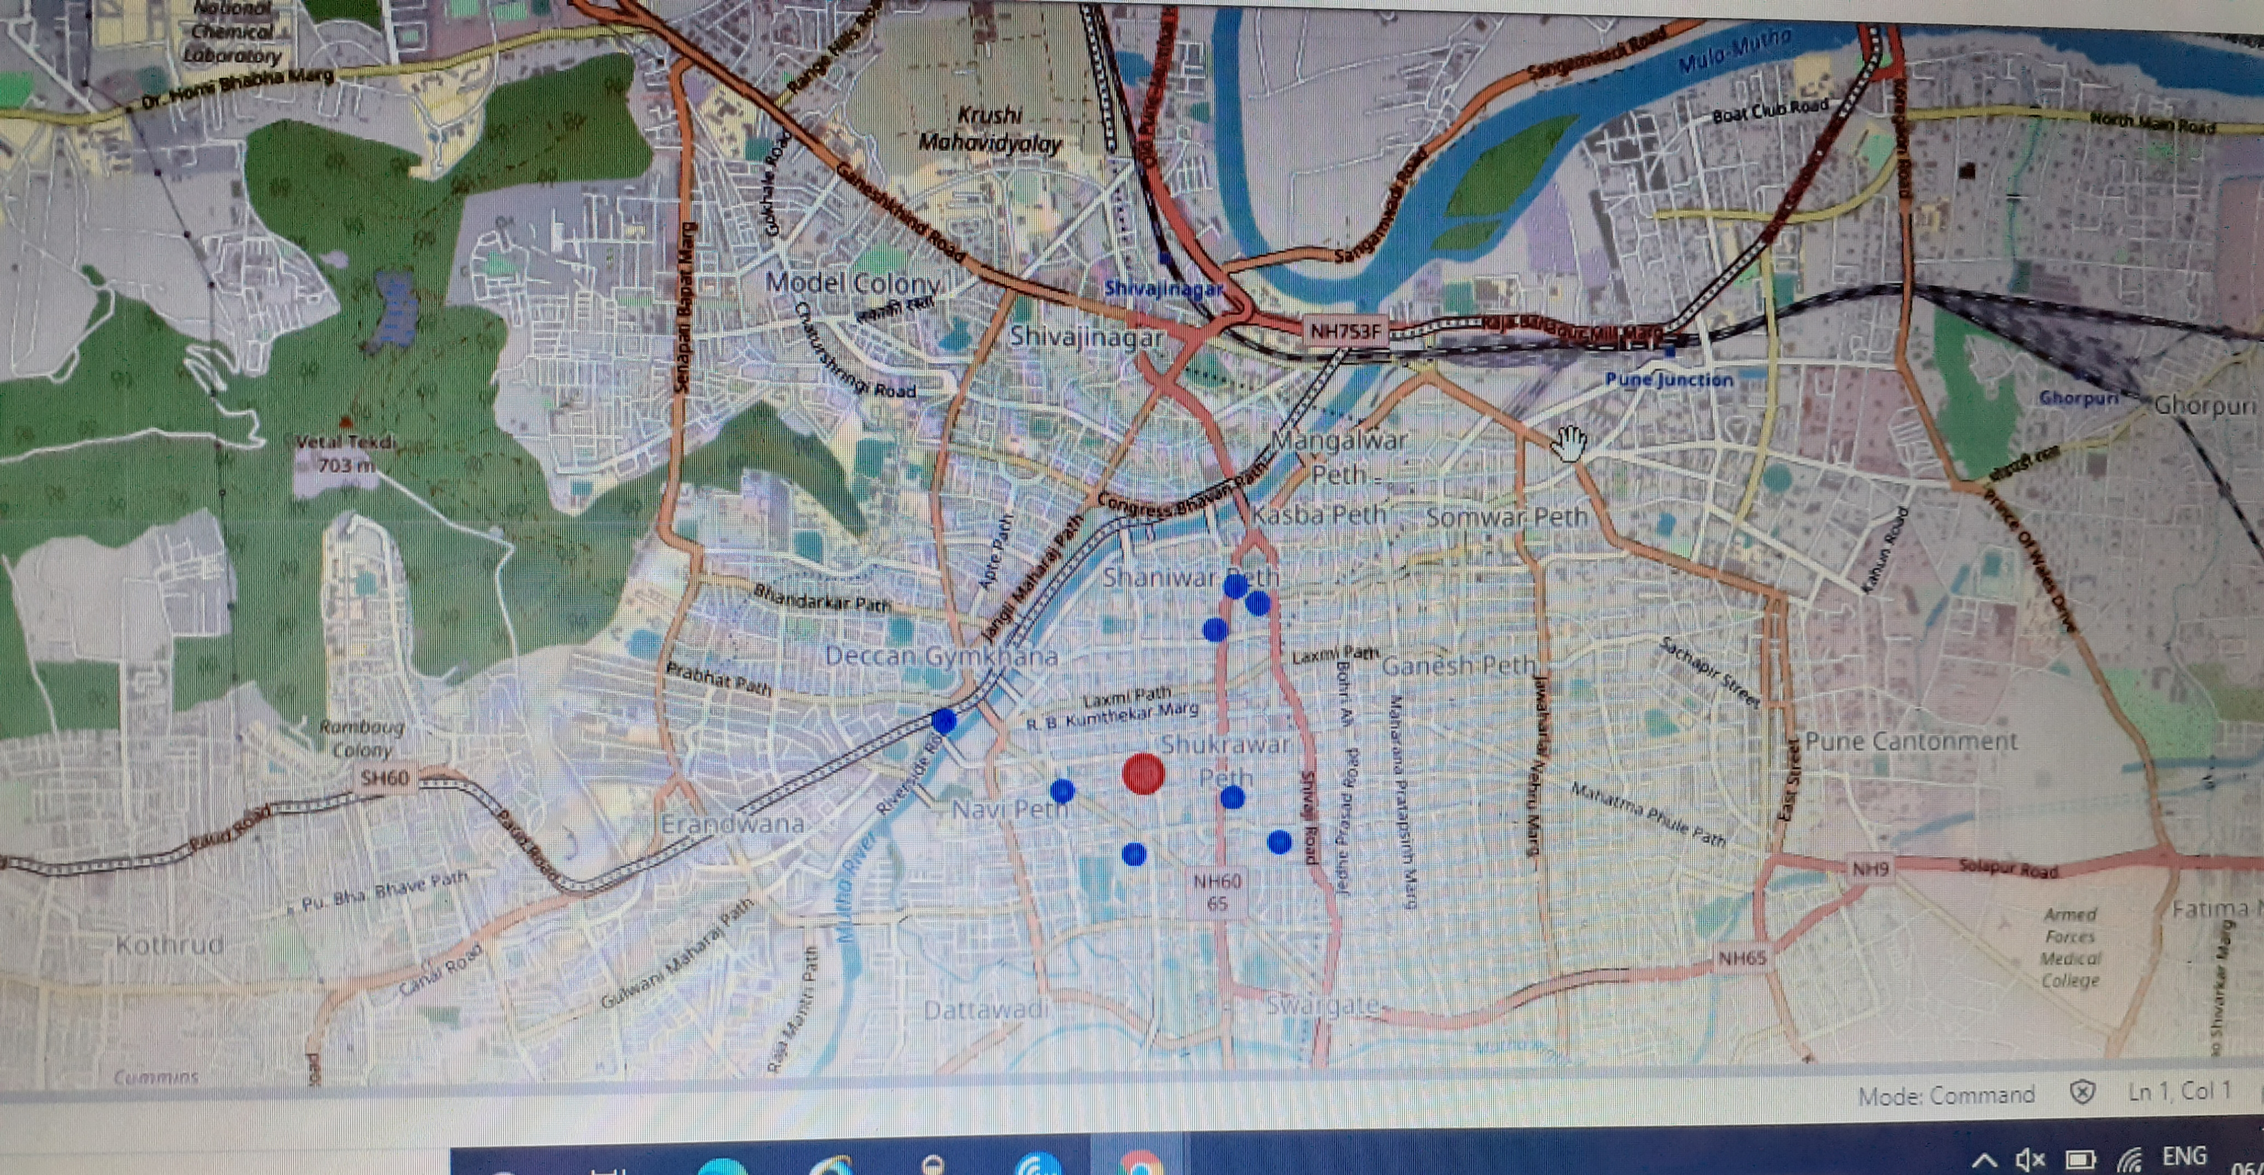
Methodology
Using Folium, I plotted a map of Sadashiv Peth highlighting colleges situated in it.
Plotted similar map for all remaining areas

Slide 10
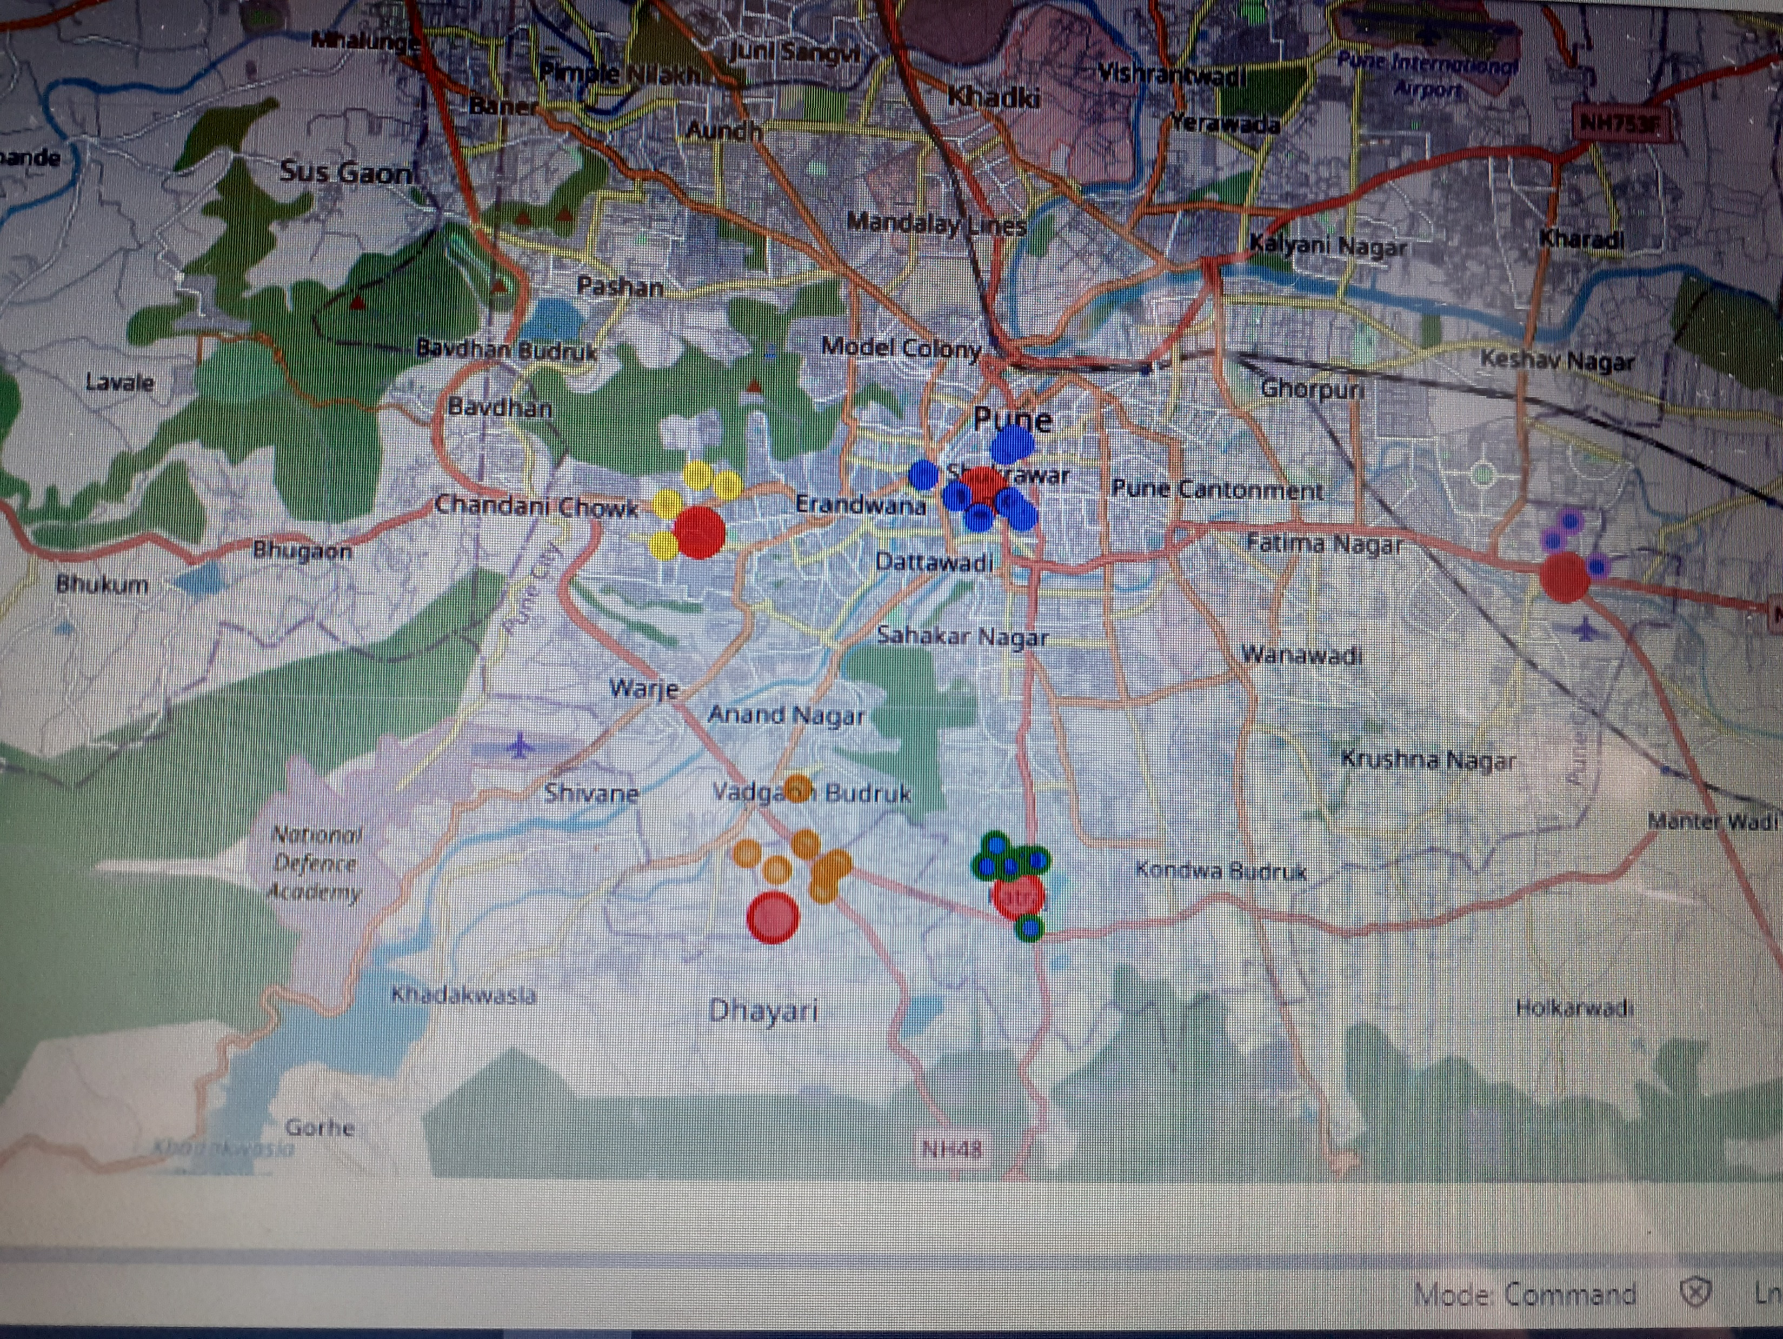
Methodology
I used the foursquare location data of 5 localities to plot a map of Pune highlighting those 5 localities with their respective colleges.

Slide 11
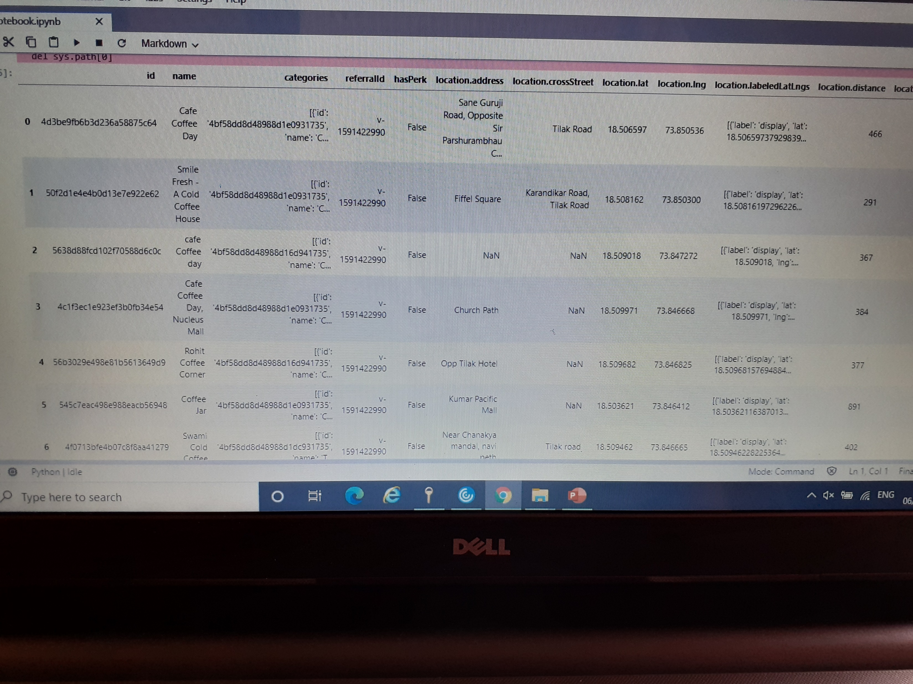
Methodology
Then I used Foursquare api again, to get a list of already present Coffee shops with details such as name, latitude, longitude and category located in each 5 localities.
The picture shows the list of coffee shops for first location ie. ‘Sadashiv Peth’
Then I got a similar list for remaining 4 areas.
Using dataframe.shape function in pandas I calculated the number of coffee shops for all the localities.

Slide 12
Methodology
Then I got a similar list for remaining 4 areas.
Using dataframe.shape function in pandas I calculated the number of coffee shops for all the localities.
Then I got a similar list for remaining 4 areas.
Using dataframe.shape function in pandas I calculated the number of coffee shops for all the localities.

Slide 13
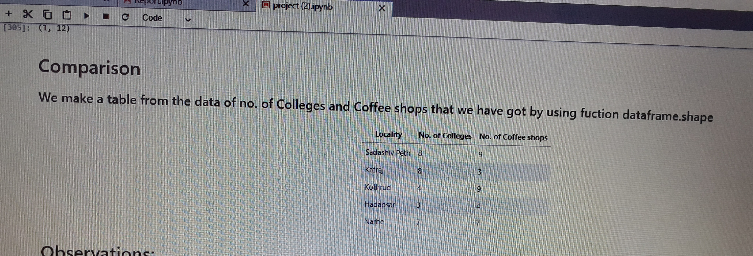
Methodology
Then I constructed a table from the observations that I got from the analysis. The table consists of the 5 localities along with their respective no. of colleges and no. of coffee shops. The table helps us to compare the localities in order to choose the best one of them for the new coffee shop.

Slide 14
Result
From the table we can observe that no. of colleges is highest in 'Sadashiv Peth' and 'Katraj’.
Both have 8 colleges ,but 'Sadashiv Peth’ has 9 already - established coffee shops and ‘Katraj’ has only 3.
Thus ‘Katraj’ has highest no. of colleges and least no. of coffee shops.

Slide 15
Conclusion
As it is favourable for the businessperson to choose a location with higher no. of colleges (ie. High no. of target customers) and lower no. of existing coffee shops (ie. Low competition); 'Katraj' would be the best solution as it has highest no. of colleges and least no. of coffee shops.
Thus, 'Katraj' is the right place to open a new coffee shop.

Slide 16
Recommendation
Now we know the area in Pune which would be best for the businessperson to open a new coffee shop. But ‘Katraj’ is a large area of land. Thus it will again require some efforts to find an exact place in Katraj for the shop.
This may be done with the help of Foursquare location data and some ground research.
For this we can refer to a map like the one given in the next slide.

